Slide 1



Department of Computer Science and Engineering
IUBAT–INTERNATIONAL UNIVERSITY OF BUSINESS AGRICULTURE AND TECHNOLOGY
Founded 1991 by Md. Alimullah Miyan
Smart Waste Management System (SWMS)
Course Code: Practicum CSC 490
Supervised by:
Md. Khairul Islam
Lecturer
Prepared by:
Md. Muradul Islam
22203234
18/5/2026

Slide 2
Contents
Analysis Modeling
Risk Management
System Interface Pictures
Project Demonstration
Limitations
Conclusion
Introduction
Features
Benefit of the Project
Software Process Model
Feasibility Analysis
Requirement Engineering
System Planning & Scheduling
2

Slide 3
Introduction
Urban waste generation is rising rapidly, but collection systems remain manual and reactive.
Smart Waste Management System (SWMS) is a Python-based desktop application that combines:
Computer-vision waste detection (bin & waste-type recognition)
Fleet management (trucks, drivers, routes, trips, maintenance)
Analytics, alerts, and PDF reporting
Built with PyQt5, SQLAlchemy/SQLite, and a YOLO-based detection model.
Designed for municipalities, waste-collection companies, and campus operations teams.
Smart Waste Management System (SWMS)
3

Slide 4
Features
Authentication & Role-Based Access Control: Admin / Supervisor / Operator
Waste Detection: image upload + real-time video detection (YOLO)
Bin Fill-Level Prediction: empty, half, almost-full, full, overflowing
Dashboard: KPIs, category distribution, 7-day & 30-day trend charts
Waste History: filter, verify/reject, delete, export to CSV/Excel
Fleet Module: Trucks, Drivers, Routes, Trips, Maintenance, Fleet Dashboard
Alerts & Rules: threshold-based, severity levels, email notifications
PDF Reports: summary, detailed, and category reports for any date range
Settings: SMTP configuration, company info, password management
Smart Waste Management System (SWMS)
4

Slide 5
Benefits of the Project
Operational Efficiency: automates waste classification and bin monitoring.
Cost Reduction: optimized routes and trip planning lower fuel & labor costs.
Data-Driven Decisions: analytics and reports support strategic planning.
Environmental Impact: Better segregation increases recycling rates.
Accountability: activity logs and role-based access ensure traceability.
Scalability: modular architecture allows adding new modules (e.g., IoT sensors, mobile apps).
Demonstrable Prototype: fully functional desktop app ready for stakeholder demos.
Smart Waste Management System (SWMS)
5

Slide 6
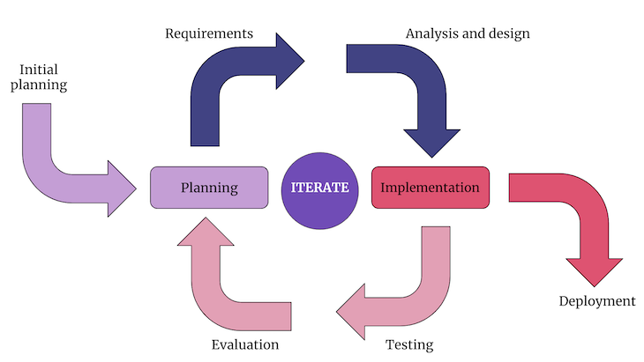
Software Process Model
Model Used: Incremental Model
The project was built in clear, working increments:
Authentication + Database Layer
Dashboard + UI Shell
Waste Detection (mock → real YOLO model)
History, Alerts, Reports
Fleet Management Module
Why Incremental?
Each module delivered working value early.
Easier to test and demo at every stage.
Accommodates evolving requirements (mock → real ML model).
Reduces risk compared to Waterfall.
Figure 1: Incremental Process Model
Smart Waste Management System (SWMS)
6

Slide 7
Feasibility Analysis
Technical Feasibility
Python stack (PyQt5, SQLAlchemy, PyTorch/YOLO) - well documented.
Runs on standard Windows / Linux machines, no special hardware required.
Economic Feasibility
Open-source dependencies - zero licensing cost.
Lightweight SQLite DB - no server infrastructure needed.
Operational Feasibility
Intuitive UI with role-based menus; minimal training required.
Runs offline; suitable for low-connectivity sites.
Smart Waste Management System (SWMS)
7

Slide 8
Requirement Engineering
User Requirement
System Requirements
Functional Requirement
Non-Functional Requirement
Smart Waste Management System (SWMS)
8

Slide 9
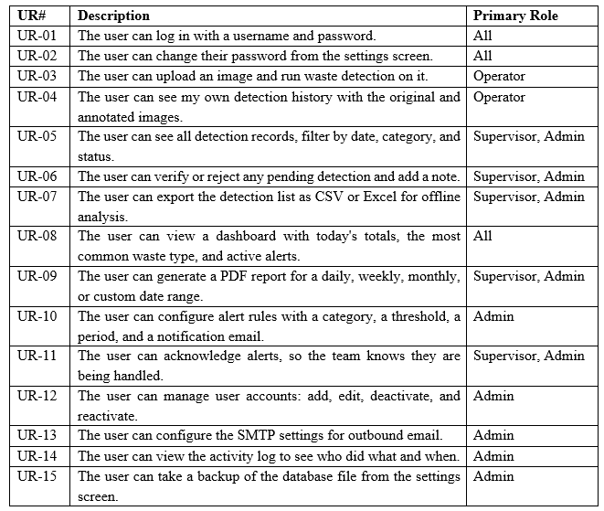
User Requirements
Smart Waste Management System (SWMS)
9

Slide 10
System Requirements
Authentication and Session Handling
1.1 User launches the app and is presented with a login screen.
1.2 Users type their login name and password and click on the Login button.
1.3 The stored bcrypt hash for the username is retrieved and compared against the password entered.
1.4 If the match succeeds, the system updates the 'Last Logged In' date on that user and brings up the main app window.
1.5 On a failed match, the system shows an “Invalid credentials” message and keeps the user on the login screen.
1.6 The user's role (admin, supervisor, or operator) is loaded, and a check_permission helper is exposed that takes the hierarchy of admin, supervisor, and operator into account for all actions protected by the system.
1.7 When the user clicks on Logout in the sidebar, it will terminate the current session and log the user out of the computer.
Smart Waste Management System (SWMS)
10

Slide 11
System Requirements
2. User Management
2.1 Admin clicks on Users from the left side menu to open the user’s management screen.
2.2 Admin pushes the Add User button, enters username, full name, email, role, and initial password, and clicks Save.
2.3 The password is hashed in the system using bcrypt, the new user is added, and an entry is added to the activity log.
2.4 Admin clicks on a user and then Edit to update the user's name, emails, or role, then Save to save the change.
2.5 Admin chooses a user and clicks Deactivate to disable the account, which is not possible if the user selected to be deactivated is the currently logged-in admin.
2.6 Admin decides to reactivate the user and clicks Reactivate to restore access to the user.
Smart Waste Management System (SWMS)
11

Slide 12
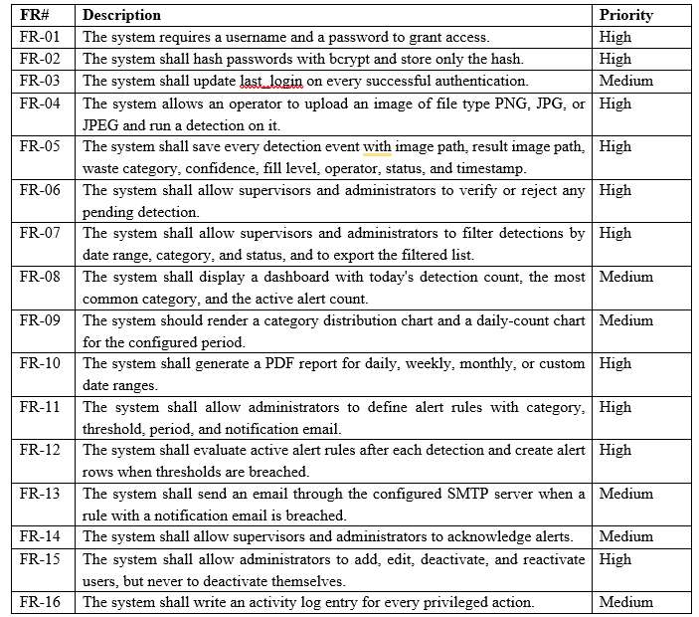
Functional Requirements
Smart Waste Management System (SWMS)
12

Slide 13
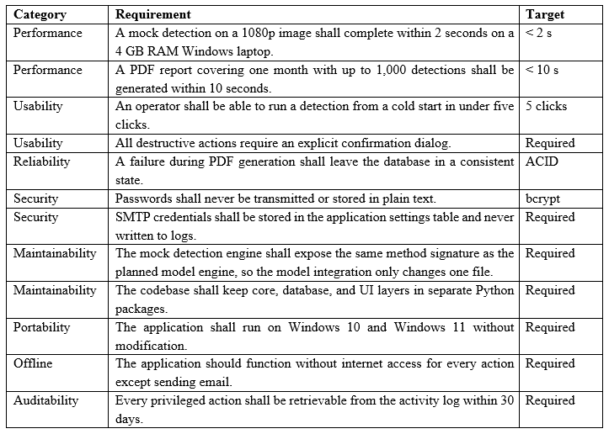
Non-Functional Requirements
Smart Waste Management System (SWMS)
13

Slide 14
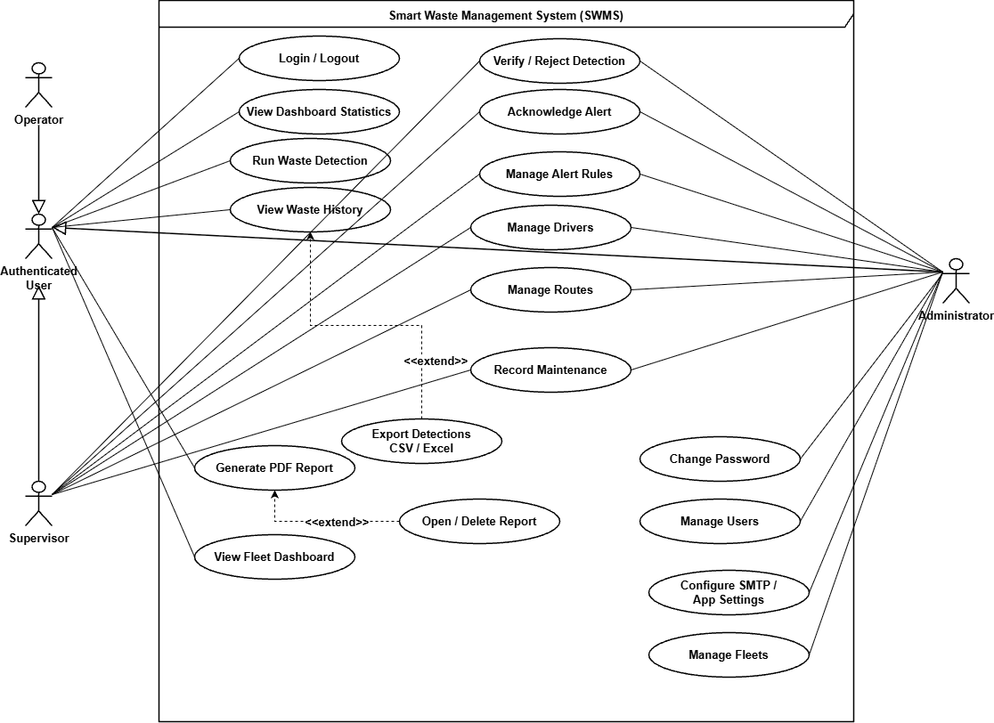
Use Case Diagram
Figure 2: Use Case Diagram
Smart Waste Management System (SWMS)
14

Slide 15
System Planning & Scheduling
Smart Waste Management System (SWMS)
15

Slide 16
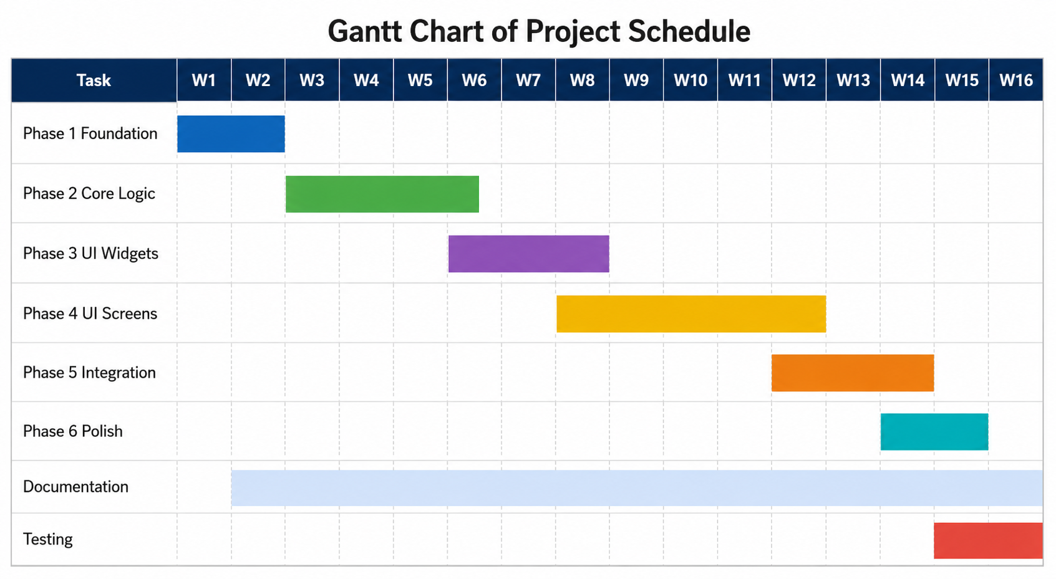
Figure 3: Gantt Chart for the Project
Smart Waste Management System (SWMS)
16

Slide 17
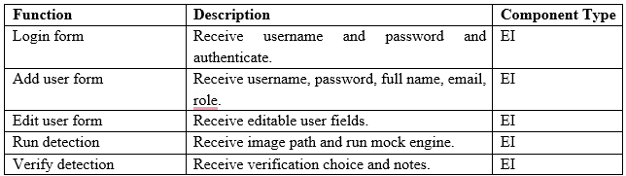
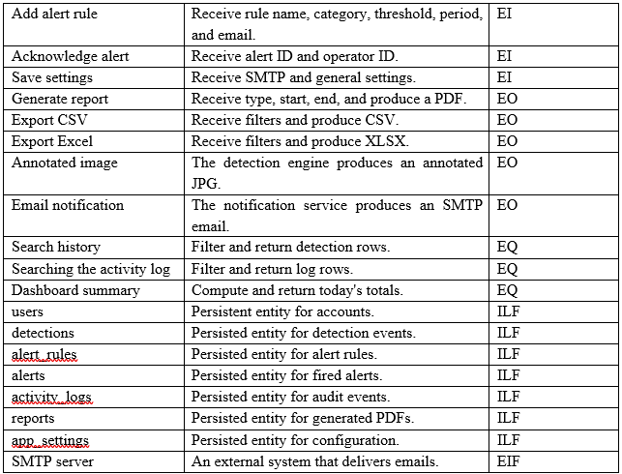
Function Point Estimation
Smart Waste Management System (SWMS)
17

Slide 18
Function Point Estimation
Table 6.1 Functionality, Input, and Output.
Smart Waste Management System (SWMS)
18

Slide 19
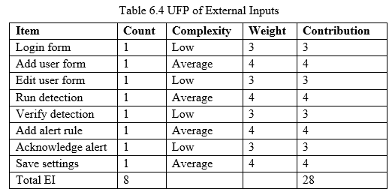
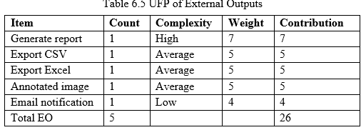
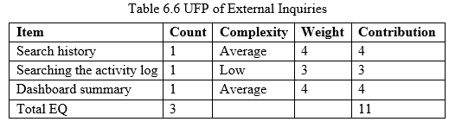
Function Point Estimation (cont.)
Smart Waste Management System (SWMS)
19

Slide 20
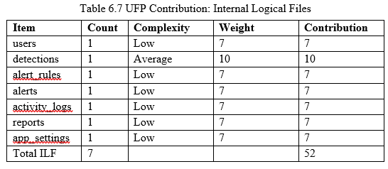

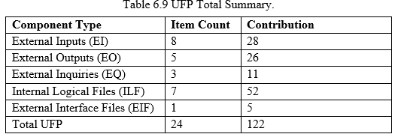
Function Point Estimation (cont.)
Smart Waste Management System (SWMS)
20

Slide 21
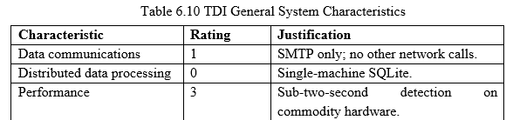
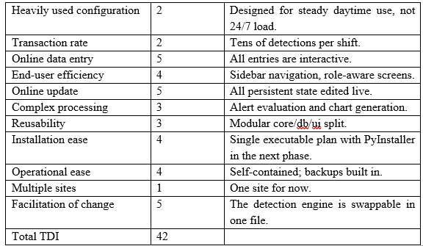
Function Point Estimation (cont.)
Smart Waste Management System (SWMS)
21

Slide 22
Project Estimation
Category | Amount (BDT)
Personnel Cost (Table 7.2) | 6,26,333
Hardware Cost (Table 7.3) | 51,000
Software Cost (Table 7.4) | 0
Other Cost (Table 7.5) | 19,000
Project Total | 6,96,333
Smart Waste Management System (SWMS)
22

Slide 23
Analysis Modeling
Smart Waste Management System (SWMS)
23

Slide 24
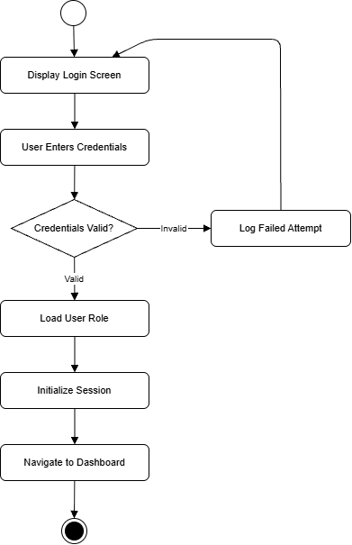
Activity Diagram
Figure 4.1 Activity Diagram: User Authentication
Smart Waste Management System (SWMS)
24

Slide 25
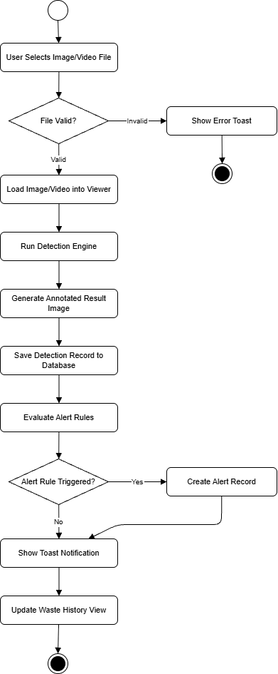
Activity Diagram
Figure 4.2 Activity Diagram: Waste Detection
Smart Waste Management System (SWMS)
25

Slide 26
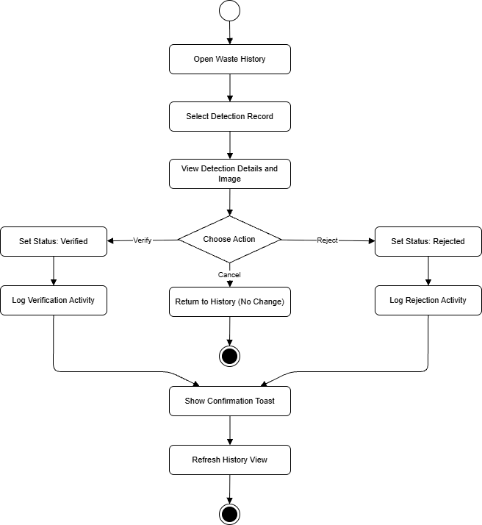
Activity Diagram
Figure 4.3 Activity Diagram: Detection Verification.
Smart Waste Management System (SWMS)
26

Slide 27
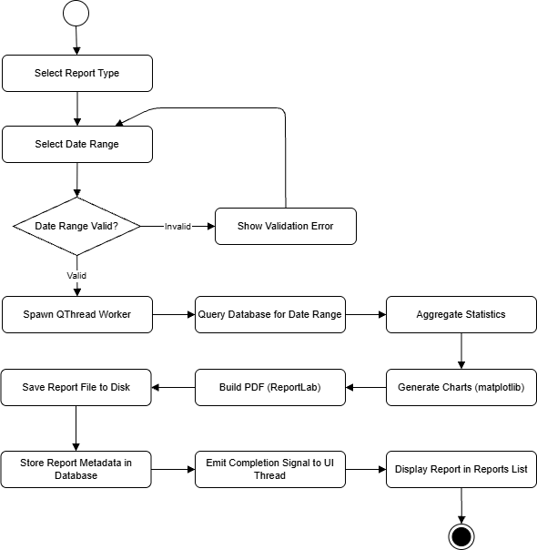
Activity Diagram
Figure 4.4 Activity Diagram: Report Generation.
Smart Waste Management System (SWMS)
27

Slide 28
Class Diagram

Slide 29
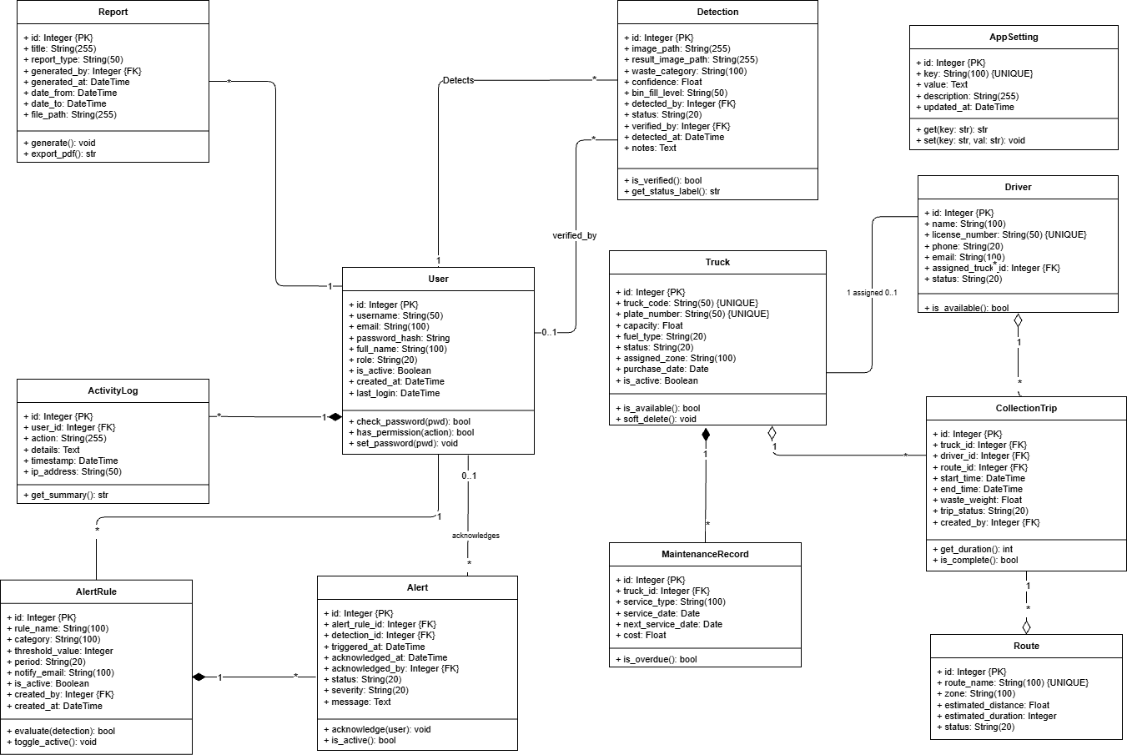
Figure 5 Class Diagram.
Smart Waste Management System (SWMS)
29

Slide 30
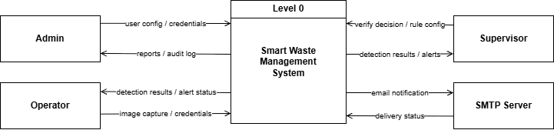
Data Flow Diagram
Figure 6.1 Level 0.
Smart Waste Management System (SWMS)
30

Slide 31
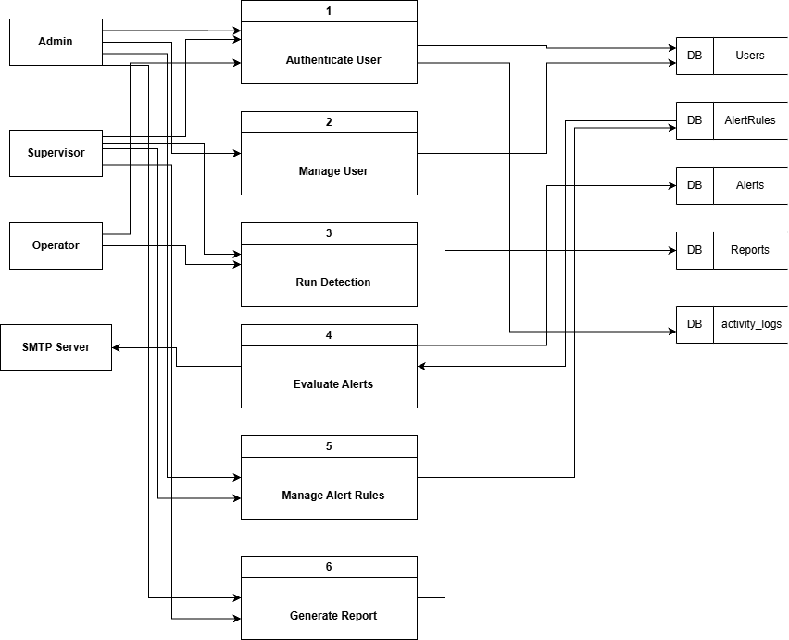
Data Flow Diagram
Figure 6.2 DFD Level 1.
Smart Waste Management System (SWMS)
31

Slide 32
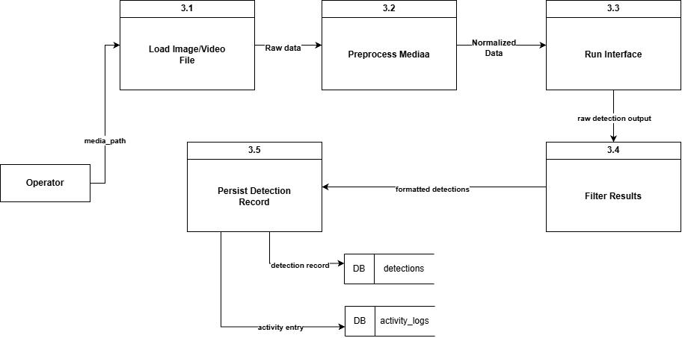
Data Flow Diagram
Figure 6.3 DFD Level 2.1.
Smart Waste Management System (SWMS)
32

Slide 33
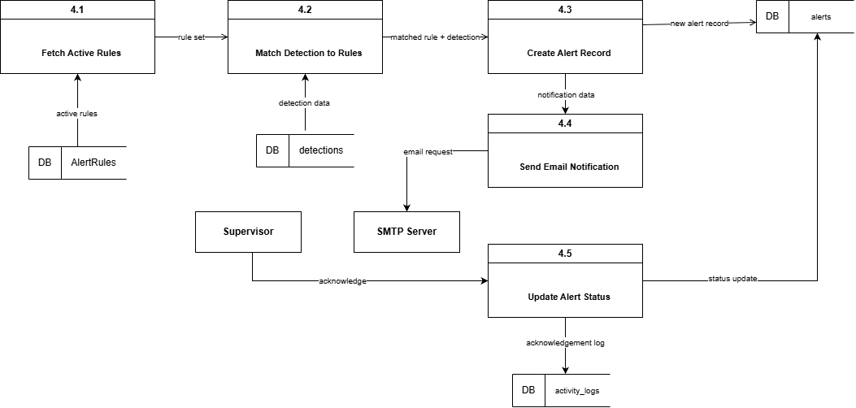
Data Flow Diagram
Figure 6.4 DFD Level 2.2.
Smart Waste Management System (SWMS)
33

Slide 34
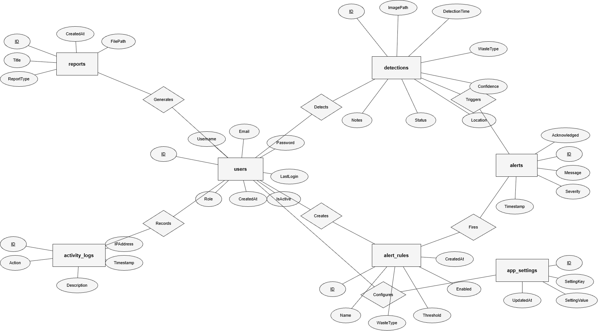
Entity Relationship Diagram
Figure 7 ERD.
Smart Waste Management System (SWMS)
34

Slide 35
Risk Management
Smart Waste Management System (SWMS)
35

Slide 36
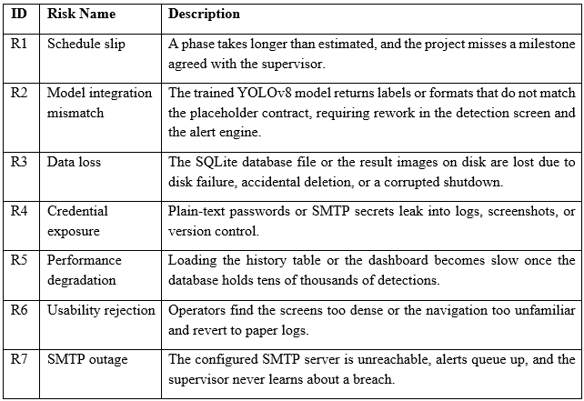
Risk Identification
Smart Waste Management System (SWMS)
36

Slide 37
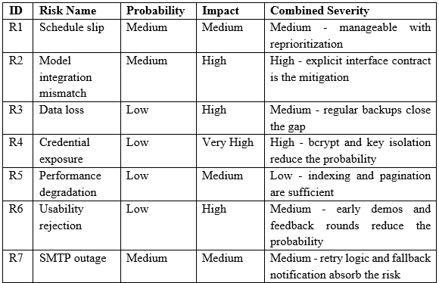
Risk Analysis
Smart Waste Management System (SWMS)
37

Slide 38
Risk Planning
ID | Risk Name | Strategy | Headline Action
R1 | Schedule slip | Mitigate | Hold the phase boundaries and trim scope inside a phase rather than extend its duration.
R2 | Model integration mismatch | Mitigate | Freeze the detection engine interface in code and write unit tests that exercise it with sample inputs.
R3 | Data loss | Mitigate | Provide an in-app backup action and document a daily backup routine.
R4 | Credential exposure | Avoid | Use bcrypt for passwords and store SMTP secrets in app_settings only; never write them to the activity log.
R5 | Performance degradation | Mitigate | Apply database indexes and paginate the history table at 25 rows per page.
R6 | Usability rejection | Mitigate | Run an early demo with two operators and incorporate feedback before the polish phase.
R7 | SMTP outage | Mitigate | Retry once with a five-second pause and surface a toast notification when delivery fails.
Smart Waste Management System (SWMS)
38

Slide 39
System Interfaces
Smart Waste Management System (SWMS)
39

Slide 40
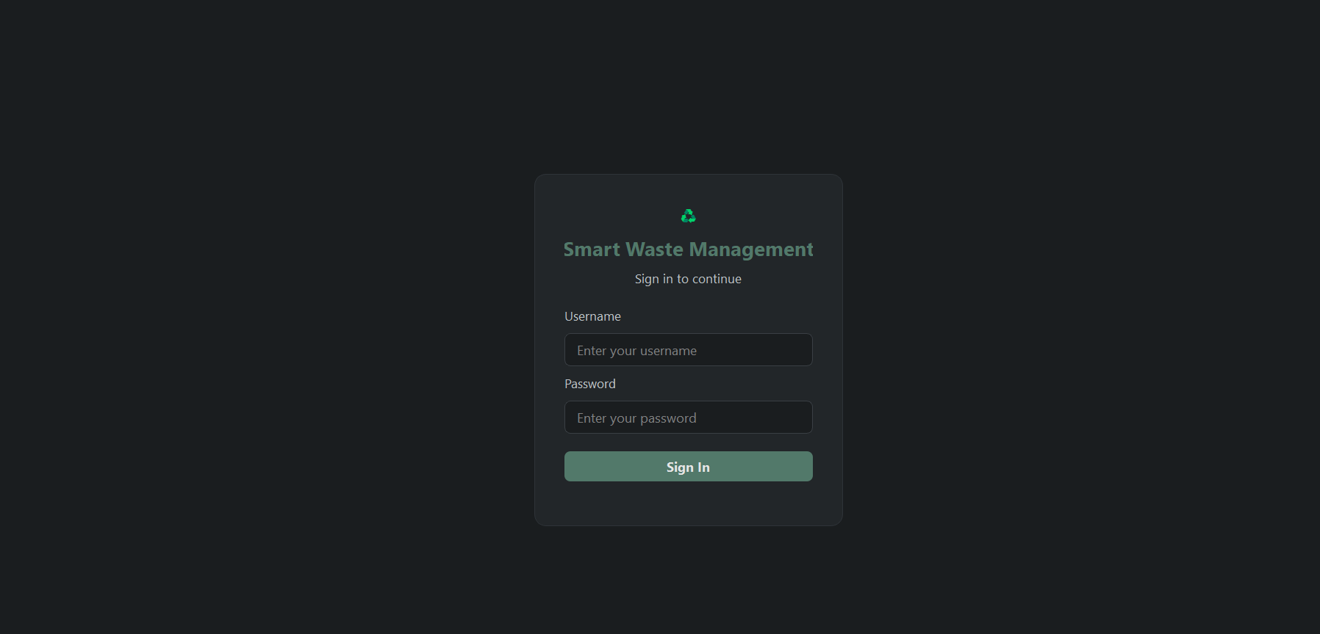
Login Screen
Smart Waste Management System (SWMS)
40

Slide 41
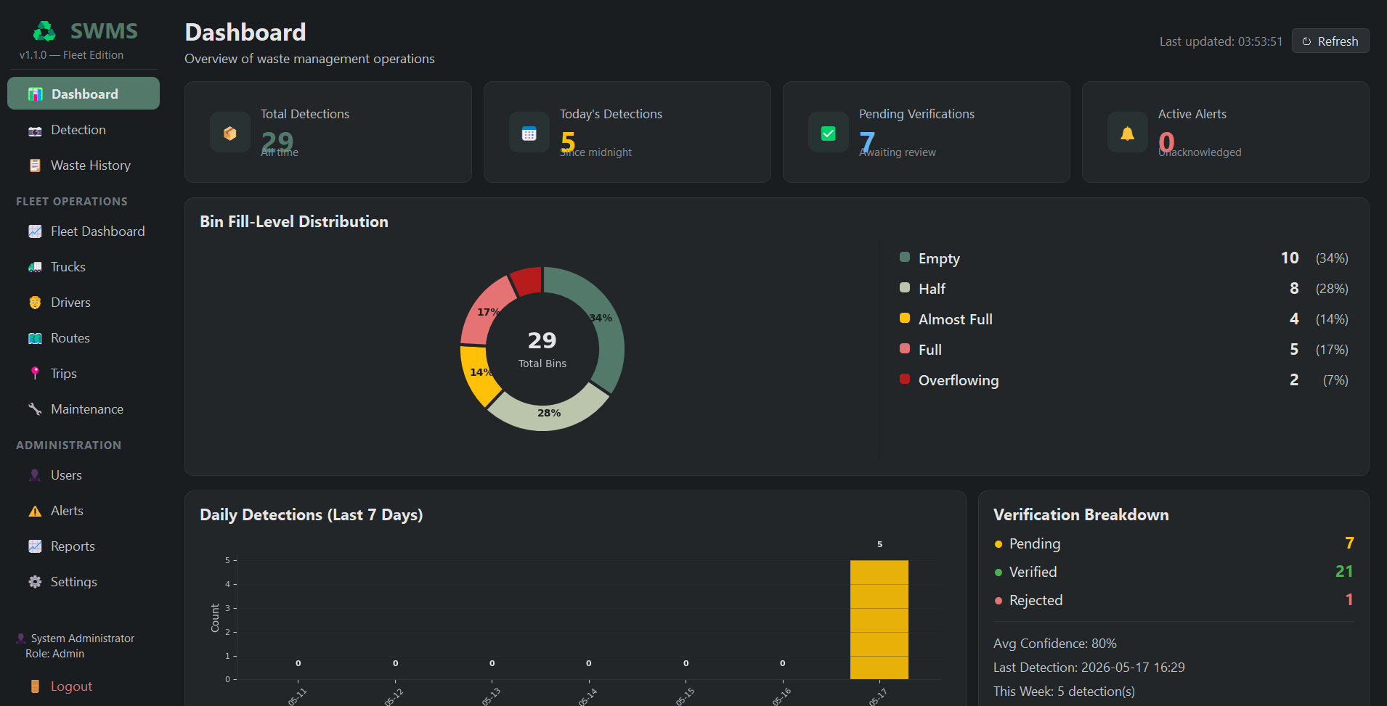
Admin Dashboard
Smart Waste Management System (SWMS)
41

Slide 42
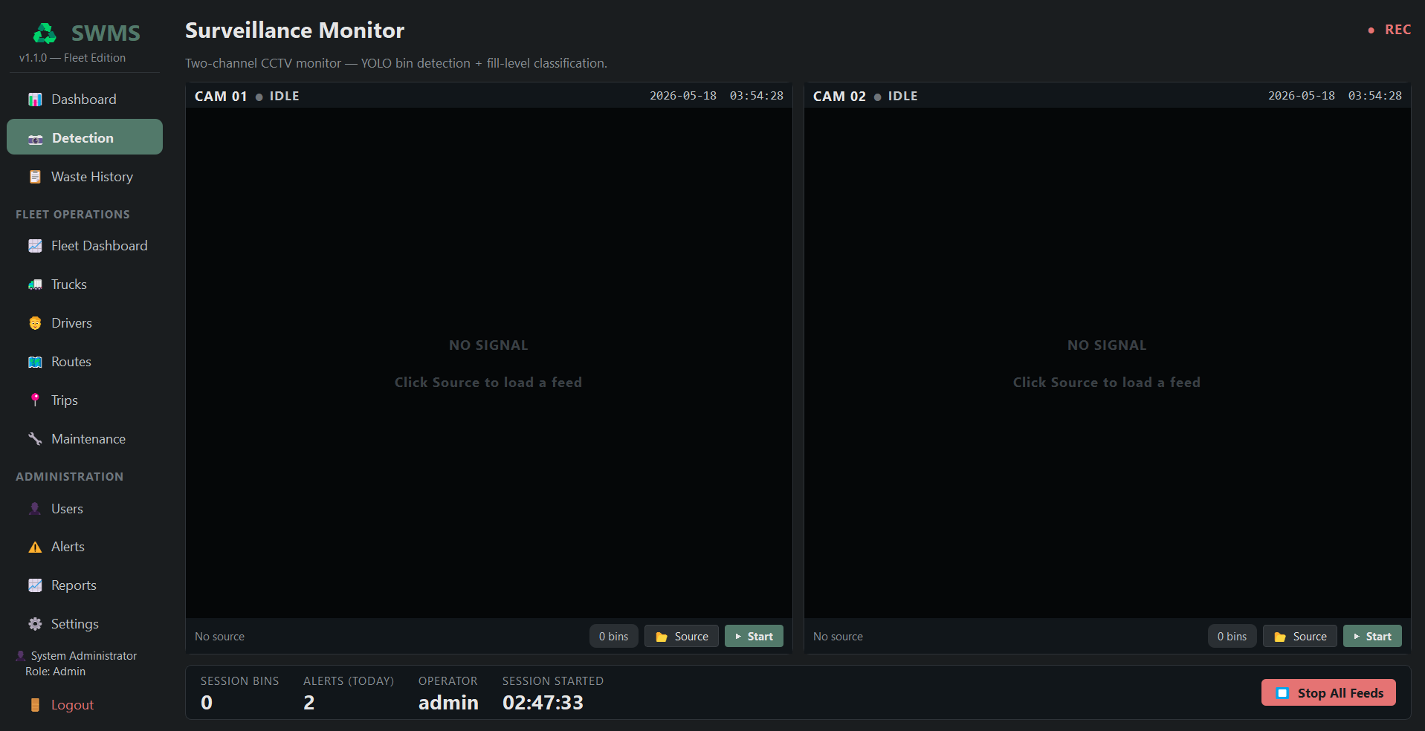
Detection Screen
Smart Waste Management System (SWMS)
42

Slide 43
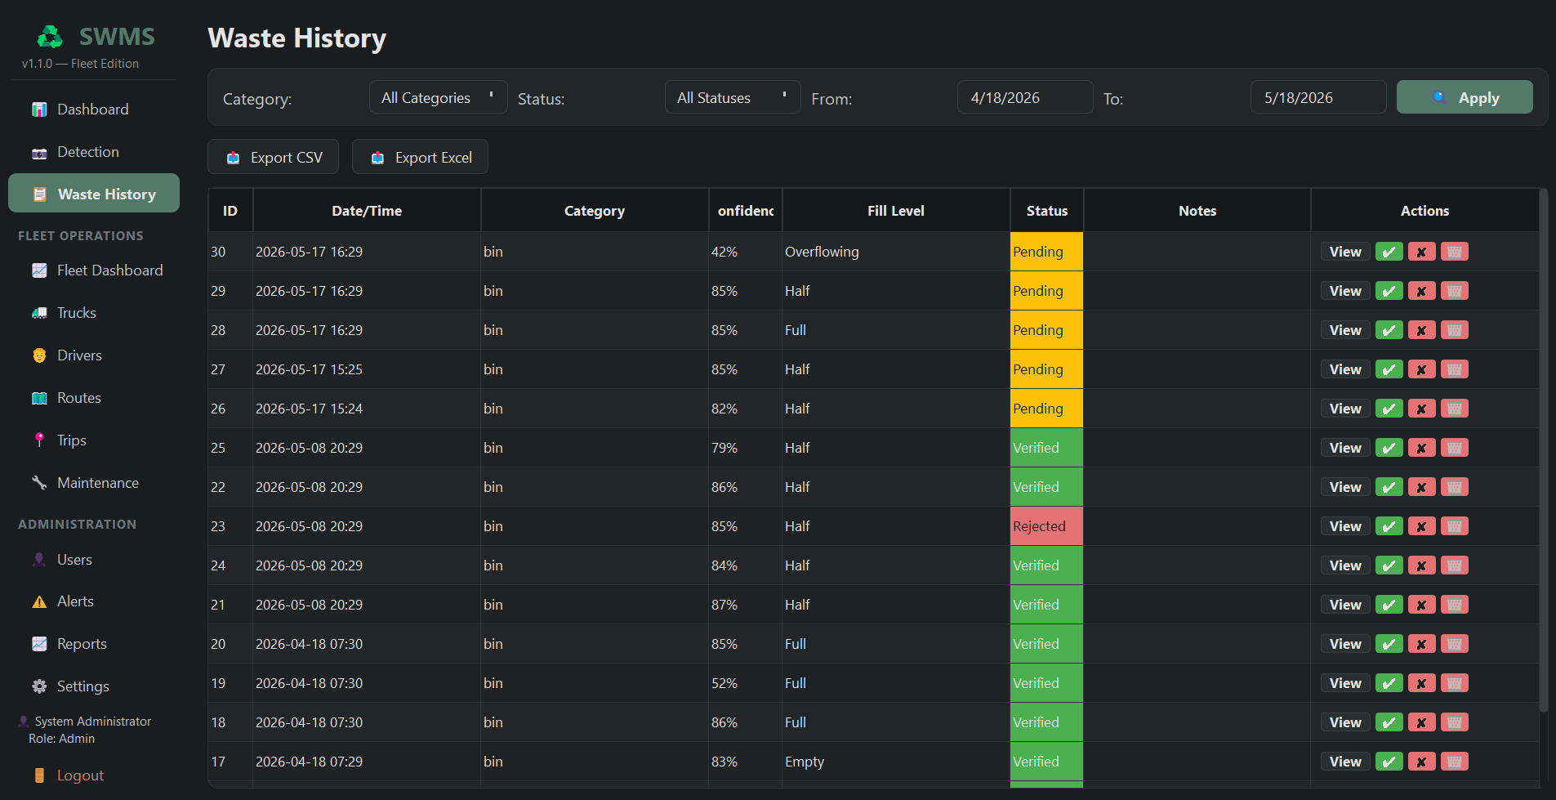
Waste History Screen
Smart Waste Management System (SWMS)
43

Slide 44
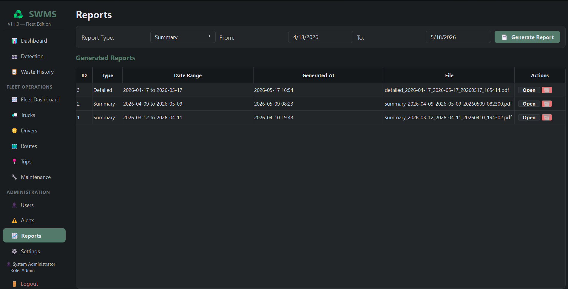
Report Screen
Smart Waste Management System (SWMS)
44

Slide 45
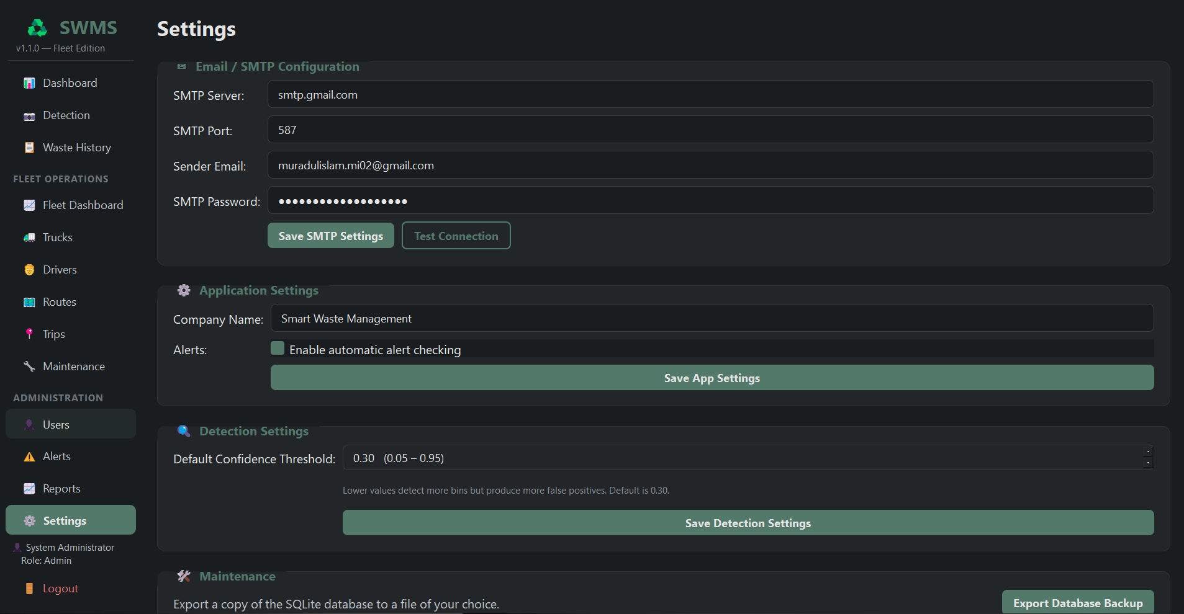
Settings Screen
Smart Waste Management System (SWMS)
45

Slide 46
Conclusion
SWMS demonstrates how computer vision + structured data management can modernize waste operations.
Delivered a fully working desktop prototype covering detection, fleet, alerts, and reporting.
Built on a modular, scalable architecture ready for future enhancements:
Cloud sync & multi-tenant support
Mobile companion app
IoT bin sensors
Advanced predictive analytics
The project successfully validates the feasibility of an affordable, offline-capable smart waste solution.
Smart Waste Management System (SWMS)
46

Slide 47
References
Adedeji, O. and Wang, Z. (2019) 'Intelligent waste classification system using deep learning convolutional neural network', Procedia Manufacturing, 35, pp. 607-612. doi: 10.1016/j.promfg.2019.05.086
Banerjee, A. and Watson, T. F. (2011) Pickard's manual of operative dentistry. 9th edn. Oxford: Oxford University Press.
Beazley, D. and Jones, B. K. (2013) Python cookbook. 3rd edn. Sebastopol: O'Reilly Media.
Bushnag, A. (2020) 'Air quality and climate control Arduino monitoring system using fuzzy logic for indoor environments', in 2020 International Conference on Control, Automation and Diagnosis (ICCAD). IEEE, pp. 1-6. doi: 10.1109/ICCAD49821.2020.9260552
Department of Environment, Bangladesh (2021) State of solid waste management in Bangladesh: 2021 status report. Dhaka: Government of Bangladesh.
Hossain, M. S. and Rahman, A. (2020) 'A study on solid waste management in Dhaka city', Journal of Environmental Science and Sustainable Development, 3(2), pp. 45-58.
Kaza, S., Yao, L., Bhada-Tata, P. and Van Woerden, F. (2018) What a Waste 2.0: A global snapshot of solid waste management to 2050. Washington: World Bank Group.
Knapik, J. J., Cosio-Lima, L. M. and Reynolds, K. L. (2015) 'Efficacy of functional movement screening for predicting injuries in coast guard cadets', The Journal of Strength and Conditioning Research, 29(5), pp. 1157-1162.
Lutz, M. (2013) Learning Python. 5th edn. Sebastopol: O'Reilly Media.
Matplotlib Development Team (2024) Matplotlib documentation. Available at: https://matplotlib.org/stable/ (Accessed: 12 March 2026).
Pahl, C. and Mani, N. (2014) 'Managing quality constraints in technology-managed learning content processes', in EdMedia 2014 World Conference on Educational Media and Technology, June 23-26, Tampere. Chesapeake: AACE, pp. 153-161.
Smart Waste Management System (SWMS)
47

Slide 48
Any Questions ?

Slide 49
Thank You

